Slide 1

Free workshop on Python
2-days workshop on Python:-
Python overview
By:- Vikas_Kr_Rawat
And their Framework (Django)
By:- Pooja Mishra
Tech With P

Slide 2
Introduction to Python
Python is a high-level programming language
Open source and Python has no need declaration
Easy to learn and write code
No need of semi colons and curly braces, uses indentation
Python is an interpreted programming language

Slide 3
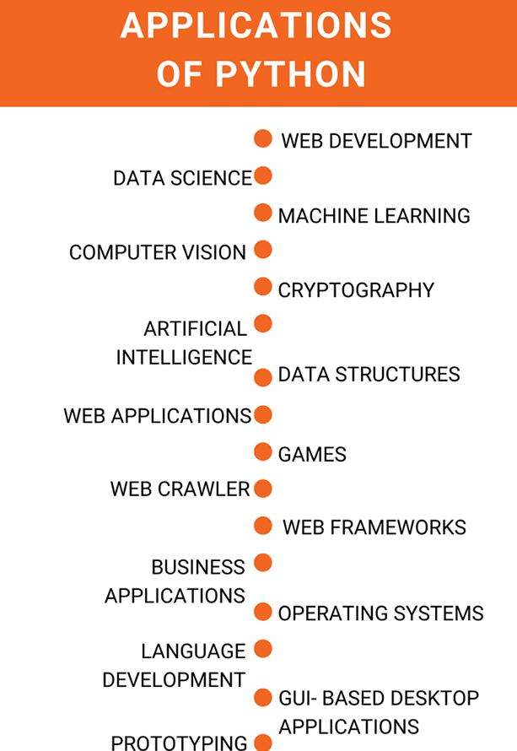
Tech_with_p

Slide 4
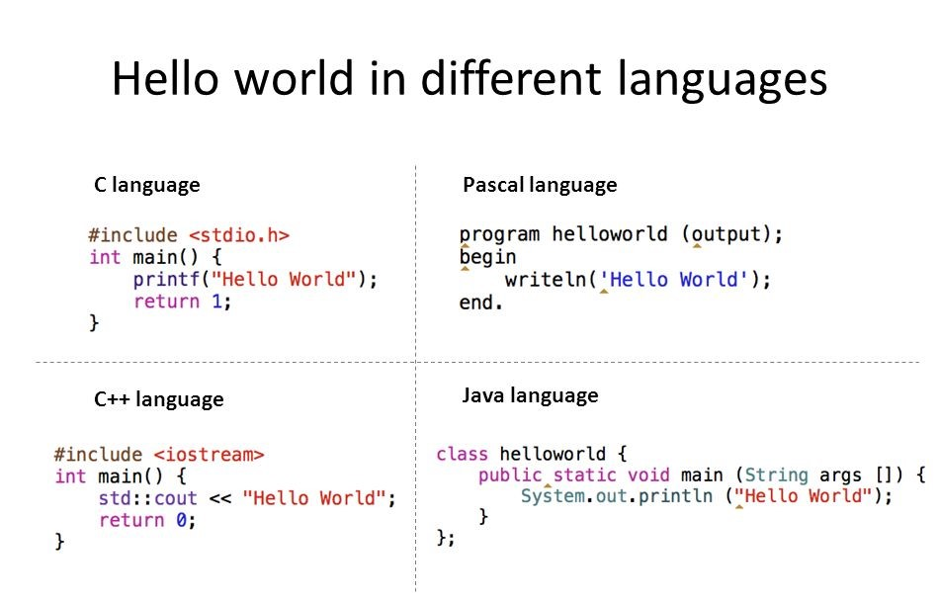
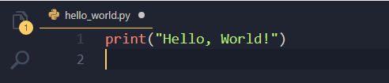
Tech_With_P

Slide 5
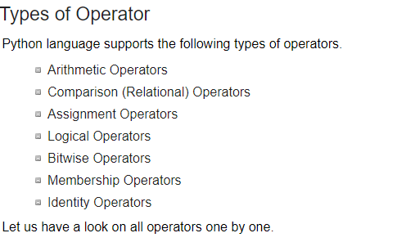
Basic operations
Assignment:
Numbers
  integer, float, complex numbers
Tech_With_p

Slide 6
String operations
concatenate with + or neighbors
  word = 'Help' + x
  word = 'Help' 'a'
subscripting of strings
  'Hello'[2] → 'l'
  slice: 'Hello'[1:2] → 'el'
  word[-1] → last character
  len(word) → 5
  immutable: cannot assign to subscript
Tech_With_p

Slide 7
Lists
lists can be heterogeneous
  a = ['spam', 'eggs', 100, 1234, 2*2]
Lists can be indexed and sliced:
  a[0] → spam
  a[:2] → ['spam', 'eggs']
Lists can be manipulated
  a[2] = a[2] + 23
  a[0:2] = [1,12]
  a[0:0] = []
  len(a) → 5
Tech_With_p

Slide 8
Tuples
Tuples is immutable
tuple = values separated by commas
>>> t = 123, 543, 'bar'
>>> t[0]
123
>>> t
(123, 543, 'bar')
Tech_with_p

Slide 9
Control flow: if
x = int(raw_input("Please enter #:"))
if x < 0:
x = 0
print 'Negative changed to zero'
elif x == 0:
print 'Zero'
elif x == 1:
print 'Single'
else:
print 'More'
no case statement
Tech_With_p

Slide 10
While loop
a,b = 0, 1
# non-zero = true
while b < 10:
# formatted output, without \n
print b,
# multiple assignment
a,b = b, a+b
Tech_With_p

Slide 11
Control flow: for
a = ['cat', 'window', 'defenestrate']
for x in a:
print x, len(x)
no arithmetic progression, but
  range(10) → [0, 1, 2, 3, 4, 5, 6, 7, 8, 9]
  for i in range(len(a)):
  print i, a[i]
do not modify the sequence being iterated over
Tech_With_p

Slide 12
Loops: break, continue, else
break and continue like C
else after loop exhaustion
for n in range(2,10):
for x in range(2,n):
if n % x == 0:
print n, 'equals', x, '*', n/x
break
else:
# loop fell through without finding a factor
print n, 'is prime'
Tech_With_p

Slide 13
SET
Remove duplicate
Set is Mutable
we can add and remove the values
Example:-
Mylist=[1,2,3,2,3,4,5,3,4,5]
print(set(Mylist)) # {1, 2, 3, 4, 5}
Tech_with_P

Slide 14
Defining functions
def fib(n):
"""Print a Fibonacci series up to n."""
a, b = 0, 1
while b < n:
print b,
a, b = b, a+b
>>> fib(2000)
First line is docstring
first look for variables in local, then global
need global to assign global variables
Tech_with_P

Slide 15
Functions: default argument values
Def MyFunction(x,y=50):
print(x,y)
MyFunciton(5,10) # 5,10
MyFunciton(10) # 10,50
Tech_With_P

Slide 16


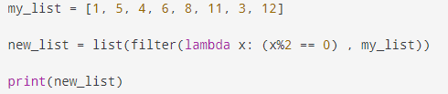
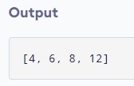
Lambda forms and Filter
Also know anonymous functions
Syntax of Lambda Function
Lambda arguments : expression
Example :-
Tech_with_p

Slide 17
List methods
append(x)
extend(L)
  append all items in list (like Tcl lappend)
insert(i,x)
remove(x)
pop([i]), pop()
  create stack (FIFO), or queue (LIFO) → pop(0)
index(x)
  return the index for value x
Tech_With_P

Slide 18
List methods
count(x)
  how many times x appears in list
sort()
  sort items in place
reverse()
  reverse list
Tech_With_P

Slide 19
List comprehensions
cross products:
>>> vec1 = [2,4,6]
>>> vec2 = [4,3,-9]
>>> [x*y for x in vec1 for y in vec2]
[8,6,-18, 16,12,-36, 24,18,-54]
>>> [x+y for x in vec1 and y in vec2]
[6,5,-7,8,7,-5,10,9,-3]
>>> [vec1[i]*vec2[i] for i in range(len(vec1))]
[8,12,-54]
Tech_With_P

Slide 20
List comprehensions
can also use if:
>>> [3*x for x in vec if x > 3]
[12, 18]
>>> [3*x for x in vec if x < 2]
[]
Tech_With_P

Slide 21
del – removing list items
remove by index, not value
remove slices from list (rather than by assigning an empty list)
>>> a = [-1,1,66.6,333,333,1234.5]
>>> del a[0]
>>> a
[1,66.6,333,333,1234.5]
>>> del a[2:4]
>>> a
[1,66.6,1234.5]
Tech_With_P

Slide 22
Dictionaries
uses 'key: value' notation
indexed by keys
dict={1: 'Tech',2: 'with',3: ‘p’}
Print(dict)
#output:- {1: 'Tech', 2: 'with', 3: 'p’}
print(dict.keys()) # 1, 2, 3
print(dict[2]) #with
print(dict.values())#['Tech', 'with’, 'p']
Tech_With_P

Slide 23
OOPs in Python
Python OOPs Concepts
1.Class.
2.Object.
3. Method.
4. Inheritance.
5. Polymorphism.
6. Data Abstraction.
7. Encapsulation.
Tech_with_p

Slide 24
Language comparison
 |  | Tcl | Perl | Python | JavaScript | Visual Basic
Speed | development | ✓ | ✓ | ✓ | ✓ | ✓
 | regexp | ✓ | ✓ | ✓
breadth | extensible | ✓ |  | ✓ |  | ✓
 | embeddable | ✓ |  | ✓
 | easy GUI | ✓ |  | ✓ (Tk) |  | ✓
 | net/web | ✓ | ✓ | ✓ | ✓ | ✓
enterprise | cross-platform | ✓ | ✓ | ✓ | ✓
 | I18N | ✓ |  | ✓ | ✓ | ✓
 | thread-safe | ✓ |  | ✓ |  | ✓
 | database access | ✓ | ✓ | ✓ | ✓ | ✓
Date :
Python :
@techwithp

